Slide 1
महाराष्ट्र राज्य माध्यमिक व
उच्च माध्यमिक विभागीय
मंडळ, पुणे

Slide 2

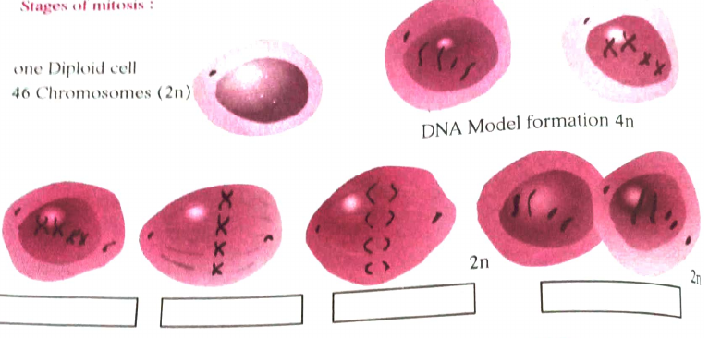
Biology and Environmental Science Practical Journal
Practicals 1 to 12, followed page by page from the original journal (PDF pages 1 to 18)
Blanks in the journal are filled with suggested answers in green. Unclear text is marked 'verify'.

Slide 3
Mitosis and Meiosis: Stages of Mitosis
Practical 1 · PDF p1 · Journal p34
Aim
To study mitosis and meiosis.
Apparatus
Permanent slides of mitosis and meiosis, compound microscope.
Procedure
Observe the permanent slides showing different stages of mitosis under a compound microscope.
Repeat the same procedure for meiosis also.
Label the following diagrams.
Figure shows
One diploid cell, 46 chromosomes (2n)
DNA model formation 4n
Two diploid cells (2n), 46 chromosomes each
Five stage-label boxes are blank in the journal: verify labels with your teacher.
Biology and Environmental Science Practical Journal
3 / 38

Slide 4
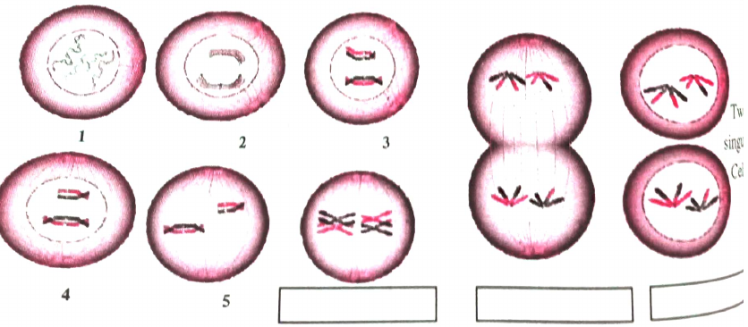
Mitosis and Meiosis: Stages of Meiosis
Practical 1 · PDF p1 · Journal p34
Diagram to label
Stages of meiosis: cells numbered 1 to 5, followed by three more stages with blank label boxes.
What to observe
Chromosomes pair up and are drawn apart in two steps
Several cells are shown, ending in four small cells
Compare each numbered cell with your permanent slide
Verify
Text at the right edge of the page is cut off in the scan ("Two ... singl... Cel..."): check against the original book.
Crop from the original journal. Empty label boxes are blank in the journal.
Biology and Environmental Science Practical Journal
4 / 38

Slide 5
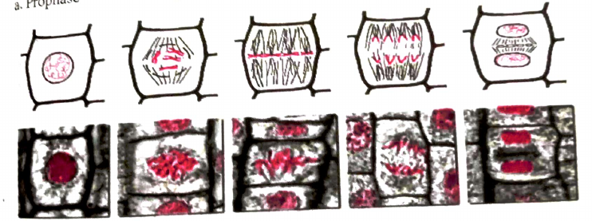
Mitosis and Meiosis: Observations and Inference
Practical 1 · PDF p2 · Journal p35
Observations: main differences (answers added)
Mitosis: one division, 2 cells. Meiosis: two divisions, 4 cells.
Mitosis occurs in body cells; meiosis in reproductive cells.
Chromosome number stays 2n in mitosis; halves to n in meiosis.
Mitosis: growth and repair. Meiosis: formation of gametes.
Inference
1. Due to mitosis the number of chromosomes in the cell remains the same (2n), therefore this division occurs in somatic (body) cells.
2. Due to meiosis the number of chromosomes in the cell becomes half (n), so this division occurs in reproductive (germ) cells.
Onion root tip cell stages shown on the journal page.
Biology and Environmental Science Practical Journal
5 / 38

Slide 6
Mitosis and Meiosis: Exercise
Practical 1 · PDF p2 · Journal p35
Q1. What would have happened if meiosis did not occur during the production of human sperm cell and egg cell?
Sperm and egg would each carry 46 chromosomes instead of 23. The zygote would then have 92 chromosomes, and the number would double in every generation. Meiosis halves the number so the zygote has the normal 46 (2n).
Answers in green are suggested; the journal leaves these lines blank.
Biology and Environmental Science Practical Journal
6 / 38

Slide 7
Mitosis and Meiosis: Multiple Choice Questions
Practical 1 · PDF p2 · Journal p35
1. A diploid cell means ...
a. n b. 2n c. 3n d. 4n
2. In this stage of mitosis, the daughter chromosomes appear like a bunch of bananas.
a. Prophase b. Metaphase c. Anaphase d. Telophase
3. During metaphase this change occurs in the chromosomes ...
a. get coil shape b. arranged parallel to equatorial plane c. get destroyed due to breaking d. get folded
4. How many times will a cell have to divide mitotically to form 128 cells?
a. 7 b. 14 c. 28 d. 32
5. Onion root supplied to observe cell division. To count the number of chromosomes, which step will you observe?
a. Prophase b. Metaphase c. Anaphase d. Telophase
MCQ answers are not given in the journal, so none are shown.
Biology and Environmental Science Practical Journal
7 / 38

Slide 8
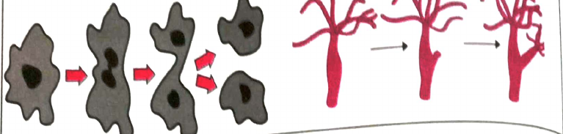
Binary Fission in Amoeba and Budding in Hydra
Practical 2 · PDF p3 · Journal p36
Aim
To study binary fission in Amoeba and budding in Hydra with the help of permanent slides.
Apparatus
Compound microscopes, permanent slides showing binary fission in Amoeba and budding in Hydra.
Observation
Amoeba: parent cell elongates, nucleus gets oval, a notch develops, two small daughter cells form
Hydra: small outgrowth on body, becomes multicellular, detaches as a bud with mouth and tentacles
Conclusion
Amoeba and Hydra reproduce by asexual method (binary fission in Amoeba, budding in Hydra).
MCQ 1
Raju observed a Hydra bud under low power, then used high power to observe ... a. micro parts in small space b. maximum space around c. maximum of bud d. All of the above.
Crop from the original journal. Empty label boxes are blank in the journal.
Biology and Environmental Science Practical Journal
8 / 38

Slide 9
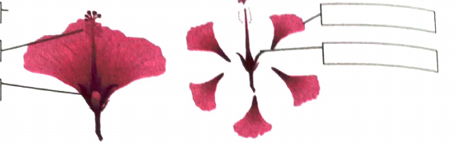
Reproductive System of the Hibiscus Flower
Practical 3 · PDF p4 · Journal p38
Aim: study the reproductive system in Hibiscus flower. Apparatus: Hibiscus flower, forcep, blade, simple microscope. Procedure: note the whorls; separate androecium and gynoecium by removing sepals and petals; take a longitudinal section from stigma to ovary; observe anthers.
Whorl | Number of components | Structure | Function
Calyx | Five | Green sepals | Protects the flower bud and inner whorls
Corolla | Five | Large coloured petals | Attracts insects for pollination
Androecium | Innumerable stamens | Anthers | To produce pollen grains
Gynoecium | One pistil | Stigma, style, ovary | Receives pollen; ovary forms fruit and seeds
Crop from the original journal. Empty label boxes are blank in the journal.
Inference: 1. Androecium from flower is the male whorl, while gynoecium is the female whorl. 2. Male gamete from pollen grain and egg cell from ovule, these two haploid cells unite to form a diploid zygote, so seed and fruit formation begins. 3. Flower is the reproductive organ of plants.
Biology and Environmental Science Practical Journal
9 / 38

Slide 10
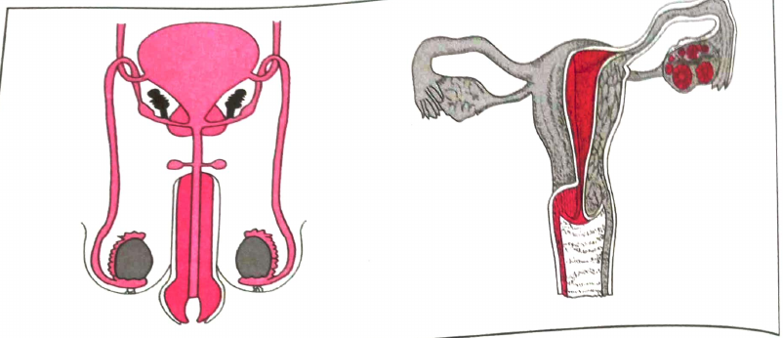
Human Reproductive Systems: Models and Diagrams
Practical 4 · PDF p5
Aim
To study human reproductive systems.
Apparatus
Models of male reproductive system and female reproductive system.
Procedure
Observe the models of the male and female reproductive systems.
Note down the different organs found in them.
Find out their functions and note down.
Label the diagrams.
Observation tables
Two tables (Sr., Name of organ, Function), filled on the next slide.
Journal figure: male (left) and female (right) systems. Labels are blank in the journal.
Biology and Environmental Science Practical Journal
10 / 38

Slide 11
Human Reproductive Systems: Observation Tables
Practical 4 · PDF p5
Sr. | Organ: Male system | Function
1 | Testes | Produce sperm cells and male hormone
2 | Vas deferens | Carries sperm from testis
3 | Seminal vesicle | Secretes fluid that nourishes sperm
4 | Prostate gland | Adds fluid to semen
5 | Urethra | Common passage for urine and semen
Sr. | Organ: Female system | Function
1 | Ovary | Produces ova and female hormones
2 | Fallopian tube | Carries ovum; site of fertilization
3 | Uterus | Embryo grows and develops here
4 | Cervix | Neck of uterus, opens into vagina
5 | Vagina | Receives sperm; birth canal
Organ names and functions in green are suggested; the journal tables are blank.
Biology and Environmental Science Practical Journal
11 / 38

Slide 12
Human Reproductive Systems: Inference and Exercise
Practical 4 · PDF p6
Inference / Conclusion
1. Male reproductive system produces haploid gametes called sperms.
2. Female reproductive system produces haploid (n) gametes called ova (egg cells).
Sperm and ovum unite to form a diploid (2n) zygote and afterwards it develops into a human embryo.
Page 6 text is slightly tilted in the scan; blanks in item 3 were read as sperm and ovum.
Biology and Environmental Science Practical Journal
12 / 38

Slide 13
Human Reproductive Systems: Exercise
Practical 4 · PDF p6
Q1. How do the characteristics of mother and father get transmitted in a human embryo?
Through chromosomes (genes). The sperm carries 23 chromosomes from the father and the ovum 23 from the mother, so the zygote has 46 and receives characters from both.
Q2. Give the names of bisexual animals.
Earthworm, leech, tapeworm.
Q3. Why is the male reproductive system called the urinogenital system?
In males the urethra carries both urine and semen, so the urinary and reproductive systems share a common passage.
Answers in green are suggested; the journal leaves these lines blank.
Biology and Environmental Science Practical Journal
13 / 38

Slide 14
Human Reproductive Systems: Multiple Choice Questions
Practical 4 · PDF p6
1. ... produces sperm cells.
a. Seminal vesicle b. Urinary bladder c. Testes d. Cowper's gland
2. The length of a sperm is ... micrometer.
a. 400 b. 5 c. 60 d. 600
3. At the time of birth, a female has ... ova in her ovary.
a. 2 to 3 lakh b. 10 to 20 lakh c. 2 to 4 lakh d. 20 to 40 lakh
4. In context to menstrual cycle, which is the wrong statement?
a. Around 40 ml of blood is discarded b. Menstrual fluid including blood easily coagulates c. Starts generally from 12th year of age d. Disturbing the cycle with hormonal tablets causes side effects
5. ... are the ways of family planning.
a. contraceptive tablets b. Nirodh (condoms) c. copper-T d. All of these
MCQ answers are not given in the journal, so none are shown.
Biology and Environmental Science Practical Journal
14 / 38

Slide 15




Comparative Study of Ecosystems
Practical 5 · PDF p7
Aim: comparative study of ecosystems in the surroundings. Apparatus: note book, pen, pencil, old newspapers etc. Select two different ecosystems in a 1 sq. km area (pond, meadow, garden, banyan, peepal, tamarind, mango, agricultural farm), note abiotic factors, collect plant samples for a herbarium scrap book, note animals found, then find differences between the biotic factors and the reasons.
Sr. | Name of the ecosystem | List of biotic factors | List of abiotic factors
1 | Pond | Lotus, algae, fish, frog, snail | Water, sunlight, temperature, dissolved oxygen
2 | Garden | Rose, grass, butterfly, earthworm, bird | Soil, sunlight, air, rainwater
3
4
Sample entries; rows 3 and 4 and your own observations are left for you. Conclusion: a pond is an aquatic ecosystem and a garden a land ecosystem, so their biotic factors differ because water, soil and other abiotic factors differ.
Biology and Environmental Science Practical Journal
15 / 38

Slide 16
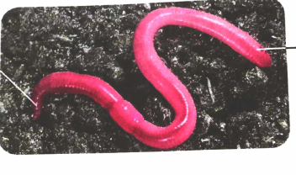
Non-Chordates: Earthworm (Annelida)
Practical 6 · PDF p8 · Journal p44
Aim
To study the characteristics of non-chordate animals: a. Earthworm b. Cockroach.
Apparatus
Live or preserved specimens of earthworm and cockroach.
Classification: Earthworm
Kingdom: Animalia
Sub-kingdom: Non-chordata
Phylum: Annelida
Example: Earthworm
Characteristics
Long cylindrical, metamerically segmented body covered with cuticle
Called 'Friend of farmer' as it dwells in land and makes it loose
Labelling boxes on the journal diagram are blank.
Biology and Environmental Science Practical Journal
16 / 38

Slide 17
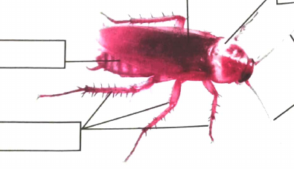
Non-Chordates: Cockroach (Arthropoda)
Practical 6 · PDF p9
Classification: Cockroach
Kingdom: Animalia
Sub-kingdom: Non-chordata
Phylum: Arthropoda
Class: Insecta
Example: Cockroach
Characteristics
Terrestrial and nocturnal insect
Head, thorax and abdomen are the three main body parts
Three pairs of jointed legs and two pairs of wings
Journal diagram with five blank label boxes.
Biology and Environmental Science Practical Journal
17 / 38

Slide 18
Non-Chordates: Multiple Choice Questions and Exercise
Practical 6 · PDF p9
1. Which special character of a non-labelled earthworm diagram places it in its phylum?
a. eye b. metamerical segmentation c. clitelum d. anus
2. Due to which similar characteristic are honey bee and cockroach in the same phylum?
a. wings b. three pairs of legs c. jointed appendages d. antenna
3. Which character is not found in cockroach?
a. compound eyes b. two pairs of wings c. no jointed appendages d. three pairs of legs with jointed appendages
4. Heart of cockroach has ... compartments.
a. 2 b. 3 c. 4 d. 13
5. Earthworm has around ... segments on its body.
a. 60 to 100 b. 100 to 120 c. 120 to 140 d. more than 140
MCQ answers are not given in the journal, so none are shown.
Biology and Environmental Science Practical Journal
18 / 38

Slide 19
Non-Chordates: Exercise
Practical 6 · PDF p9
Q1. Make a list of other animals in the phylum Annelida.
Leech, Nereis (sandworm).
Q2. What are the organs of locomotion in Annelids?
Setae (bristles) with muscles; Nereis also has parapodia.
Q3. What is the reproductive speciality of Annelids?
Earthworm and leech are bisexual (hermaphrodite) and show cross-fertilization; Nereis has separate sexes.
Q4. The exoskeleton of Arthropods is made of which material?
Chitin.
Answers in green are suggested; the journal leaves these lines blank.
Biology and Environmental Science Practical Journal
19 / 38

Slide 20
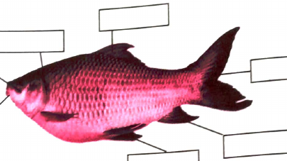
Chordates: Fish (Rohu)
Practical 7 · PDF p10 · Journal p46
Aim
To study the characteristics of chordate animals: a. Fish b. Pigeon.
Apparatus
Live or preserved specimens of fish and pigeon.
Procedure
Observe the specimens: a prominent character of the phylum; changes with reference to adaptation.
Label the diagrams.
Classification: Fish
Kingdom: Animalia Phylum: Chordata
Sub-phylum: Vertebrata Class: Pisces
Example: Rohu fish
Characteristics
Cold blooded, spindle-shaped body to minimize water resistance
Breathes with gills
Fish diagram: five blank label boxes in the journal.
Biology and Environmental Science Practical Journal
20 / 38

Slide 21
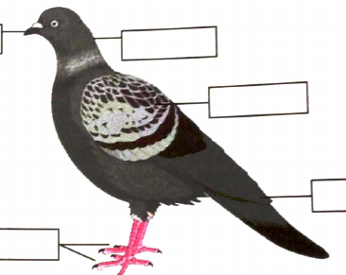
Chordates: Pigeon (Aves)
Practical 7 · PDF p11 · Journal p47
Classification: Pigeon
Kingdom: Animalia Phylum: Chordata
Sub-phylum: Vertebrata Class: Aves
Example: Pigeons
Characteristics
Body covered with feathers
Forelimbs modified into wings
Heart has four compartments
Hollow bones and air bags inside the body: aerial adaptation
Pigeon diagram: five blank label boxes in the journal.
Biology and Environmental Science Practical Journal
21 / 38

Slide 22
Chordates: Multiple Choice Questions and Exercise
Practical 7 · PDF p11 · Journal p47
1. Fish is ... blooded animal.
a. mix b. cold c. warm d. None of above
2. Pigeon's heart has ... compartments.
a. 1 b. 2 c. 3 d. 4
3. Due to which similar character are birds and fishes in the same phylum?
a. tapering head b. heavy chest c. caudal fin d. vertebral column
4. The caudal fin of fish and pigeon is useful to ...
a. increase the velocity b. decrease the velocity c. change direction d. maintain balance
5. Bird's ... are modified into wings.
a. forelimbs b. hindlimbs c. thorax parts d. none of these
MCQ answers are not given in the journal, so none are shown.
Biology and Environmental Science Practical Journal
22 / 38

Slide 23
Chordates: Exercise
Practical 7 · PDF p11 · Journal p47
Q1. Explain the adaptation in fish body which makes floating on water as well as going in deep water easy.
Fish have an air (swim) bladder that is filled or emptied to change buoyancy, and a streamlined spindle-shaped body that reduces water resistance.
Q2. Which factor decides whether the animal is 'cold blooded' or 'warm blooded'?
Control of body temperature. Warm-blooded animals keep a constant body temperature; in cold-blooded animals it changes with the surroundings.
Q3. What are the changes in birds' bodies that adapt them to aerial habitat?
Feathers, forelimbs modified into wings, streamlined body, hollow bones, air bags and a four-chambered heart.
Answers in green are suggested; the journal leaves these lines blank.
Biology and Environmental Science Practical Journal
23 / 38

Slide 24
Acetic (Ethanoic) Acid: Properties
Practical 8 · PDF p12
Aim: study physical and chemical properties of acetic acid. Apparatus: test tubes, test tube stands. Chemicals: acetic acid, red and blue litmus solutions, sodium bicarbonate.
Sr. | Test | Observations | Inference
1 | Odour | Odour like vinegar | Acetic acid has vinegar like odour.
2 | Solubility in water | Acetic acid dissolves in water. | Acetic acid is soluble in water
3a | Blue litmus | Turns red | Acetic acid is acidic in nature.
3b | Red litmus | Does not change colour
4a | Reaction with sodium bicarbonate | Colourless and odourless gas bubbles evolved | Carbon dioxide gas is evolved when acetic acid reacts with sodium bicarbonate.
4b | Pass this gas through lime water | At first lime water turns milky; with more gas it becomes colourless again
Biology and Environmental Science Practical Journal
24 / 38

Slide 25
Acetic (Ethanoic) Acid: Procedure and Apparatus
Practical 8 · PDF p12
Apparatus and chemicals
Test tubes, test tube stands; acetic acid, red and blue litmus solutions, sodium bicarbonate.
Procedure
Take 2 to 3 ml acetic acid in a clean, dry test tube. Note its colour and odour.
Add 4 to 5 ml water to the acetic acid and mix well.
Take 2 ml acetic acid in a test tube and add blue litmus solution. Do the same for red litmus. Observe both tubes.
Take 2 ml acetic acid in a test tube and add a pinch of sodium bicarbonate. Observe.
Gas passed through
Acetic acid + sodium bicarbonate: gas bubbles
Lime water
Schematic of test 4 (not a figure in the journal).
Biology and Environmental Science Practical Journal
25 / 38

Slide 26
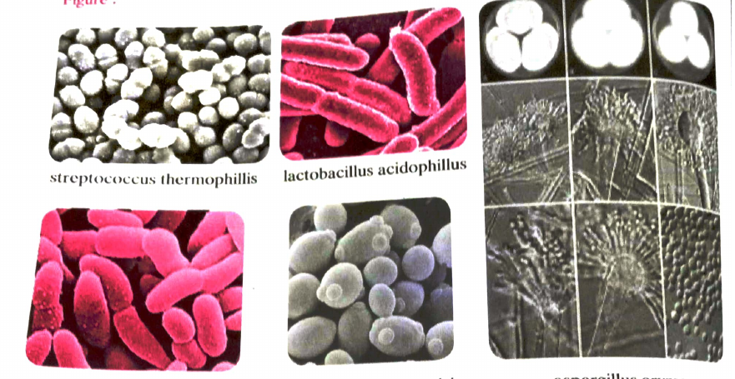
Industrially Useful Microbes
Practical 9 · PDF p13 · Journal p50
Aim
To study the characteristics of microbes that are industrially useful.
Apparatus
Compound microscope and permanent slides of: streptococcus thermophilis, lactobacillus acidophilus, saccharomyces serevisiae, acetobacter, aspergillus oryzae.
Procedure
Select any four permanent slides, observe under compound microscope and note characteristics.
Find out industrial application / use of each.
Observation table
Sr. No, Name of the microbe, Type, Characteristics: 5 blank rows in the journal.
Left to right: streptococcus, lactobacillus, aspergillus; below: acetobacter, saccharomyces.
Biology and Environmental Science Practical Journal
26 / 38

Slide 27
Industrially Useful Microbes: Observation Table
Practical 9 · PDF p13 · Journal p50
Sr. No, Name of the microbe, Type, Characteristics (blank in journal; suggested entries for the five listed microbes).
Sr. No | Name of the microbe | Type | Characteristics and use
1 | Streptococcus thermophilus | Bacterium (round) | Makes curd and yoghurt from milk
2 | Lactobacillus acidophilus | Bacterium (rod-shaped) | Lactic acid fermentation; curd
3 | Saccharomyces cerevisiae | Yeast (fungus) | Oval budding cells; bread and alcohol
4 | Acetobacter | Bacterium (rod-shaped) | Makes vinegar from alcohol
5 | Aspergillus oryzae | Fungus (mould) | Fermentation; makes enzymes
Biology and Environmental Science Practical Journal
27 / 38

Slide 28
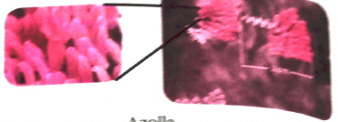
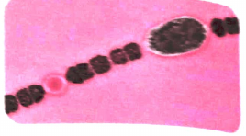
Biofertilizers: Azolla and Anabaena
Practical 10 · PDF p14 · Journal p52
Azolla
Kingdom Plantae · Division Pteridophyta · Example Azolla
Floats on steady water such as ponds and lakes
2.5 cm long triangular leaves with soft bristles: velvety layer
Destroys worms in water (wormicide nature)
Cyanobacterium Anabaena azolli in leaves fixes atmospheric nitrogen
Anabaena
Kingdom Bacteria · Division Cyanobacteria · Example Anabaena
Filamentous bacteria living symbiotically with azolla, the mosquito fern
Fix atmospheric nitrogen; found in paddy fields as natural fertilizer
Animals stay away: neurotoxins harm nervous system
Aim: study biofertilizers Azolla, Anabaena, Azotobacter, Nostoc (aim line is blurred: verify). Procedure: observe specimens, label diagrams.
Biology and Environmental Science Practical Journal
28 / 38

Slide 29
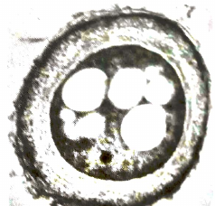
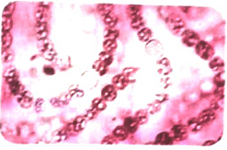
Biofertilizers: Azotobacter and Nostoc
Practical 10 · PDF p14 to p15 · Journal p52
Azotobacter
Kingdom Bacteria · Division Proteobacteria
Round or oval, diameter 1 to 2 micrometer
Creates a hard crust around itself; lives independently in soil
Fixes atmospheric nitrogen
Nostoc
Kingdom Bacteria · Division Cyanobacteria
Strings embedded in gelatinous covering
Found in soil, wet rocks, bottoms of water reservoirs
Independent or symbiotic; supplies nitrogen to host
Autotrophic (chlorophyll); used as food, rich in vitamins and proteins
Conclusion (journal): Anabaena in azolla works as a biofertilizer; Azotobacter fixes nitrogen in soil; Nostoc can photosynthesize.
Biology and Environmental Science Practical Journal
29 / 38

Slide 30
Biofertilizers: Multiple Choice Questions
Practical 10 · PDF p15
1. The wormicide character of ... destroys worms in water.
a. azatobacter b. azolla c. nostoc d. none of these
2. Nostoc is used as food because it has abundant ... and ...
a. proteins and vitamin C b. carbohydrates and lipids c. water and vitamin D d. carbohydrates and proteins
3. The bacteria ... supply natural manure to paddy fields.
a. azolla b. anabaena c. azatobater d. nostoc
4. Which of the following bacteria can perform photosynthesis?
a. anabaena b. azatobacter c. nostoc d. none of these
5. Nitrogen fixing bacteria anabaena are found in the plant ...
a. anabaena b. pistia c. salvinia d. marselia
MCQ answers are not given in the journal, so none are shown.
Biology and Environmental Science Practical Journal
30 / 38

Slide 31
Biofertilizers: Exercise
Practical 10 · PDF p15
Q1. Why do microbes play an important role in agricultural management?
Microbes such as Azolla with Anabaena, Azotobacter and Nostoc fix atmospheric nitrogen and enrich the soil. They work as natural biofertilizers, so less chemical fertilizer is needed and the soil stays fertile.
Answers in green are suggested; the journal leaves these lines blank.
Biology and Environmental Science Practical Journal
31 / 38

Slide 32

Disaster Management: Electrical Audit Survey Chart
Practical 11 · PDF p16 · Journal p54
Aim: survey of our building regarding disaster management. Give one mark each to the proper answer; write total marks of each survey in conclusions.
Sr. | What to be audited? | Observations Yes/No/Remark | Marks
1 | Is the electric connection done by licensed electrician?
2 | Is the earthing properly done?
3 | Is the building provided with Lightening Arrester?
4 | Are the electrical equipments I.S.I. marked?
5 | Are the electrical wire joints open?
6 | Do the wires have proper insulations?
7 | Is there regular checking of cables / wires around the building?
8 | Is there any protective grid around electric pole?
9 | Are buckets filled with sand kept ready to extinguish electrical fire?
10 | Do the electric equipments have three pin sockets?
 | Total Marks
Biology and Environmental Science Practical Journal
32 / 38

Slide 33

Disaster Management: Construction Audit Survey Chart
Practical 11 · PDF p16 to p17 · Journal p54 to p55
Same marking rule: one mark each to the proper answer.
Sr. | What to be audited? | Observations Yes/No/Remark | Marks
1 | Are the inner and outer surfaces of the building properly plastered and painted?
2 | Is the construction done under supervision of proper architect?
3 | Are the columns/beams of the building cracked?
4 | Any changes made to original structure at the time of renovation?
5 | Is there leakage through water and sewage pipes?
6 | Do the children play outdoor games on the terrace? (causes damage and leakage to the slab)
7 | Is there regular repairing and painting of the building?
8 | Is structural audit of the building done regular?
9 | In monsoon, does the water logs in the building area for more than 48 hours?
10 | Do your area experience earthquakes regularly?
 | Total Marks
Biology and Environmental Science Practical Journal
33 / 38

Slide 34

Fire Control Management Audit Survey Chart
Practical 11 · PDF p17 · Journal p55
Same marking rule: one mark each to the proper answer.
Sr. | What to be audited? | Observations Yes/No/Remark | Marks
1 | Does the building have fire-extinguisher?
2 | Is it in working condition?
3 | Does staircase have spaces more than 5 square feet?
4 | Is there an alternative exit to your building?
5 | Is the list of contact numbers of fire brigades kept at front side of the building?
6 | Is there any scrap kept near the main electrical connections area?
7 | Does the fire brigade arrange regular Mock Drills?
8 | Are there any inflammable chemicals kept in building or home premises?
9 | Is the gas cylinder kept away from fridge?
10 | Is each floor provided with enough first aid material?
 | Total Marks
Biology and Environmental Science Practical Journal
34 / 38

Slide 35
Disaster Management: Conclusion
Practical 11 · PDF p17 · Journal p55
According to the above observations, your home/building has secured the following marks:
Sr. No. | Type of Audit | Marks | Remark
1 | Electrical Audit
2 | Construction Audit
3 | Fire Control Management Audit
Three blank lines for conclusion and a line for Remark and Signature follow in the journal.
Biology and Environmental Science Practical Journal
35 / 38

Slide 36
Carbon Dioxide Evolved in Respiration
Practical 12 · PDF p18 · Journal p57
Aim
To show that carbon dioxide is evolved in the process of respiration.
Apparatus and chemicals
25 to 30 lentil seeds (mung, mutki), water, cotton, conical flask, bent tube, rubber cork; potassium hydroxide pellets.
Procedure
Soak seeds overnight, keep in wet cotton so they sprout.
Put wet sprouts in a conical flask.
Insert a test tube with KOH pellets in the flask.
Fit a rubber cork with bent tube, air tight.
Dip other end of tube in coloured water; mark level.
Keep steady 15 minutes; mark level again; note observations.
Bent tube
KOH pellets in test tube
Conical flask
Sprouted seeds
Coloured water
Schematic of the set-up described in the procedure. The journal page has no figure.
Biology and Environmental Science Practical Journal
36 / 38

Slide 37
Respiration: Observation and Multiple Choice Questions
Practical 12 · PDF p18 · Journal p57
1. Observation: CO2 evolved in respiration is absorbed by KOH (potassium hydroxide), therefore water level in bent tube rises.
Inference: Carbon dioxide gas is evolved during respiration in plant.
2. Arrange the steps in proper order: i) soak gram seeds overnight, keep in conical flask; ii) close flask with cork fitted with 'U' tube; iii) insert test tube with KOH solution; iv) keep the set steady for some time.
a. i,ii,iii,iv b. i,ii,iv,iii c. i,iii,ii,iv d. i,iii,iv,ii
3. Decomposition is a type of ...
a. aerobic respiration b. anaerobic respiration c. exothermic reaction d. none of these
MCQ answers are not given in the journal, so none are shown.
Biology and Environmental Science Practical Journal
37 / 38

Slide 38
Revision: Major Topics in the Journal
Practicals 1 to 12 · PDF p1 to p18
1 Mitosis and meiosis: cell division stages, 2n and n
2 Amoeba binary fission, Hydra budding
3 Hibiscus whorls: calyx, corolla, androecium, gynoecium
4 Human male and female reproductive systems
5 Comparative study of ecosystems: biotic and abiotic
6 Earthworm (Annelida) and cockroach (Arthropoda)
7 Fish (Pisces) and pigeon (Aves), adaptations
8 Acetic acid: odour, solubility, litmus, NaHCO3 test
9 Industrially useful microbes
10 Biofertilizers: Azolla, Anabaena, Azotobacter, Nostoc
11 Disaster management audits: electrical, construction, fire
12 CO2 evolved in respiration of germinating seeds
Biology and Environmental Science Practical Journal
38 / 38

Slide 39
मनःपूर्वक आभार!
श्री औदुंबर उकिरडे, अध्यक्ष विभागीय मंडळ पुणे
डॉ. सौ मीनाक्षी राऊत, सचिव विभागीय मंडळ पुणे
सौ वैशाली काळे, सहसचिव विभागीय मंडळ पुणे

